Slide 1

K-Special Interest Group
“Highlight your Biosketch”
Alison K. Hall, Ph.D.
Associate Dean for Research Workforce Development
Professor of Neurology,
The GWU School of Medicine and Health Sciences
akhall@gwu.edu

Slide 2
Today:
Prepare for the Application
Focus on the Biosketch
Personal Statement
Positions & Honors
feedback
Contributions to Science
Research Support
feedback
Resources

Slide 3
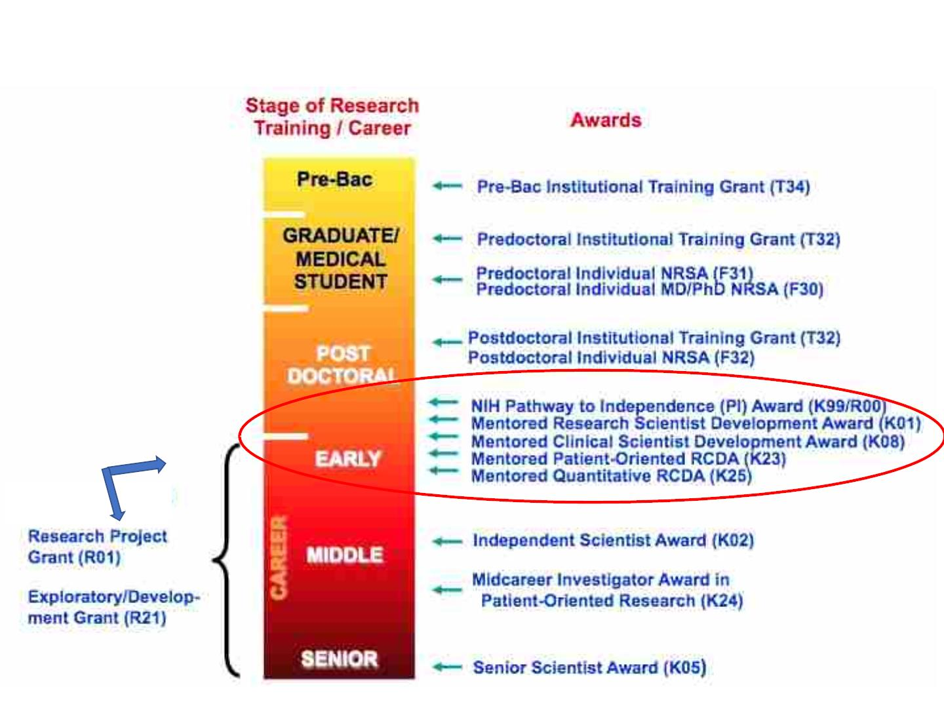
K grants in the grand scheme of things…
Institutional
KL2, K12

Slide 4
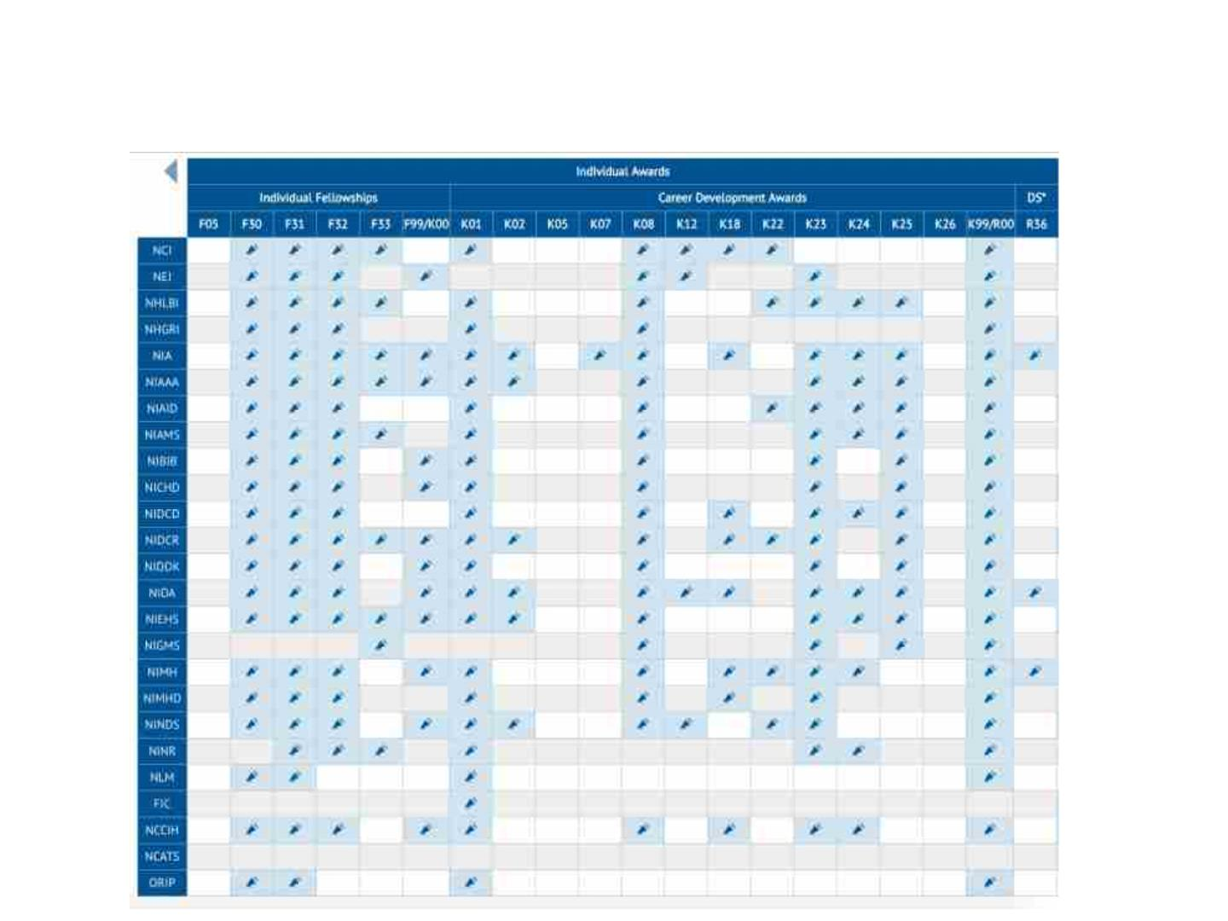
Not every NIH Institute has every K
https://researchtraining.nih.gov/institute

Slide 5
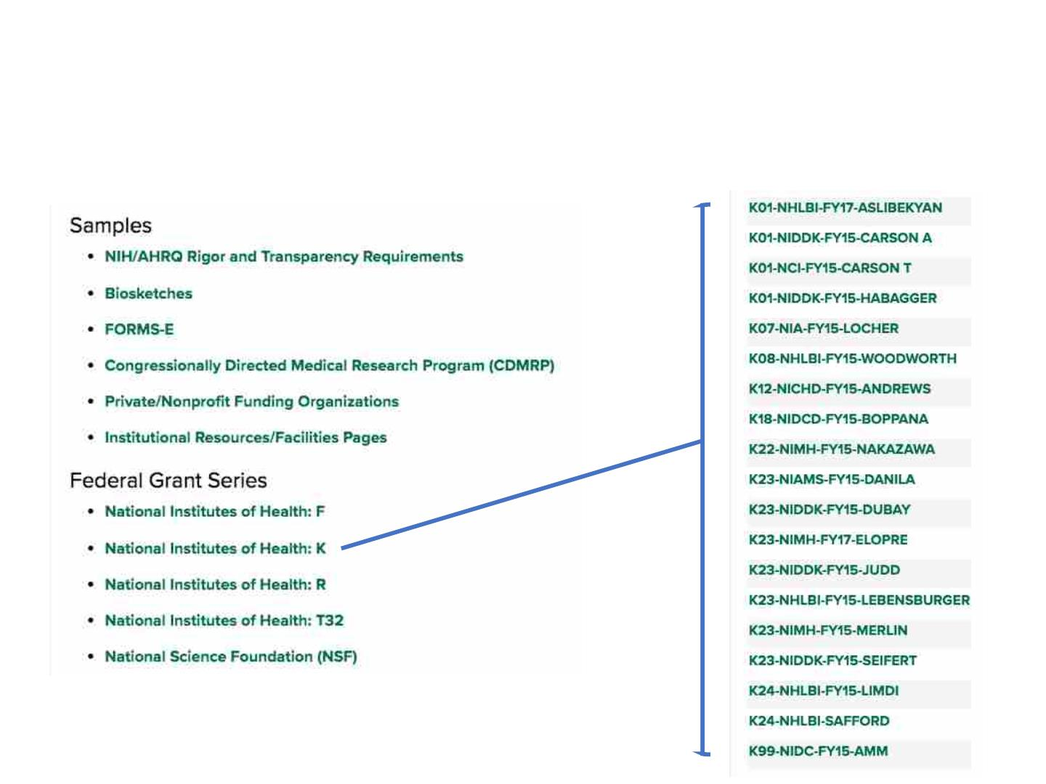
See Sample Successful Applications
University of Alabama Birmingham Grants Library
https://www.uab.edu/ccts/research-commons/grant-help/proposal-development/grant-library

Slide 6

Sections of a K23 Application
Project summary/ abstract
Project narrative
(Intro to resubmission)
Candidate information & goals
Research Strategy
30 lines
3 sentences
1 page
6 pages
6 pages
1 page
Specific aims
Training in RCR
1 page
Plans and Statements of Mentor 6 pages
Letters of support
6 pages
1 page
1 page
5 pages
Institutional environment
Instit commit to career devel
Biographical sketch

Slide 7
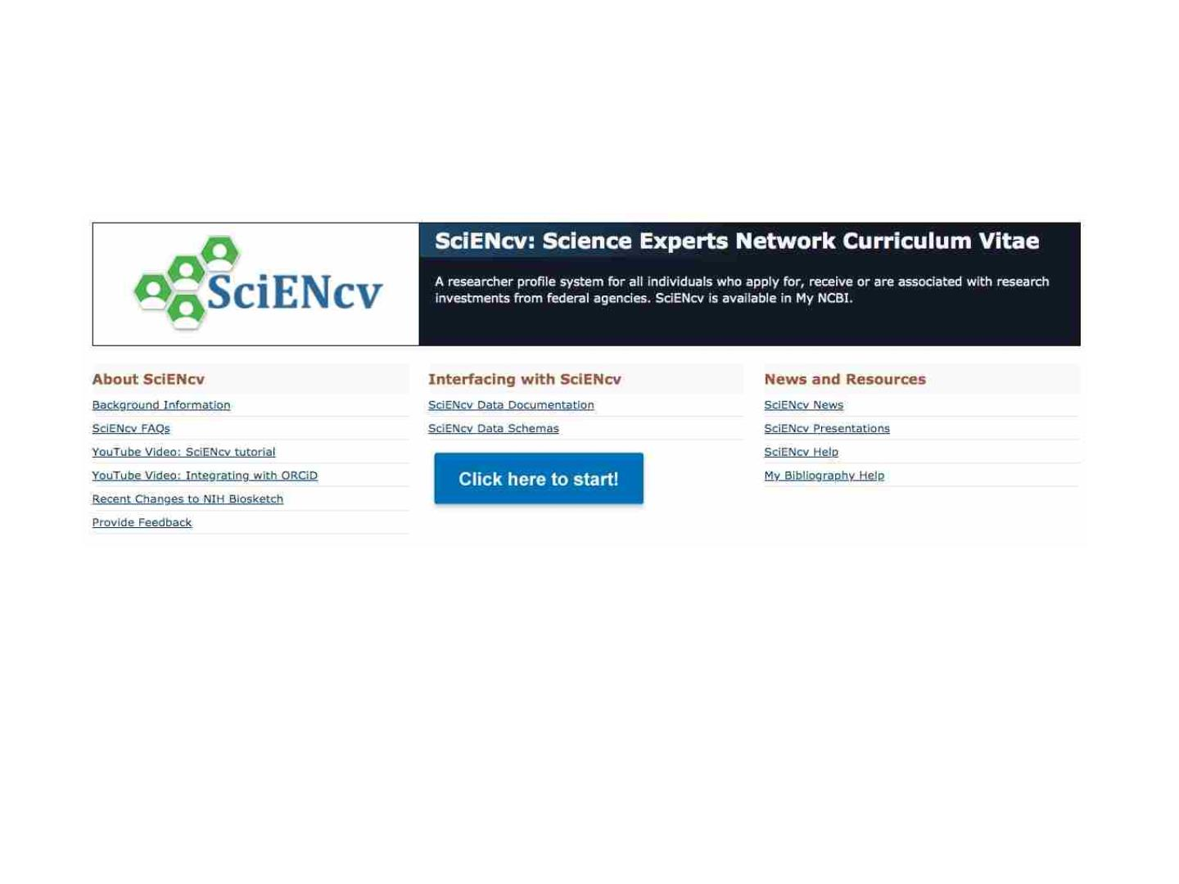
Your Curriculum Vitae isnot your NIH Biosketch
Manage your biosketch online with SciENCV
https://www.ncbi.nlm.nih.gov/sciencv/
Anyone with a MyNCBI account can use SciENcv

Slide 8
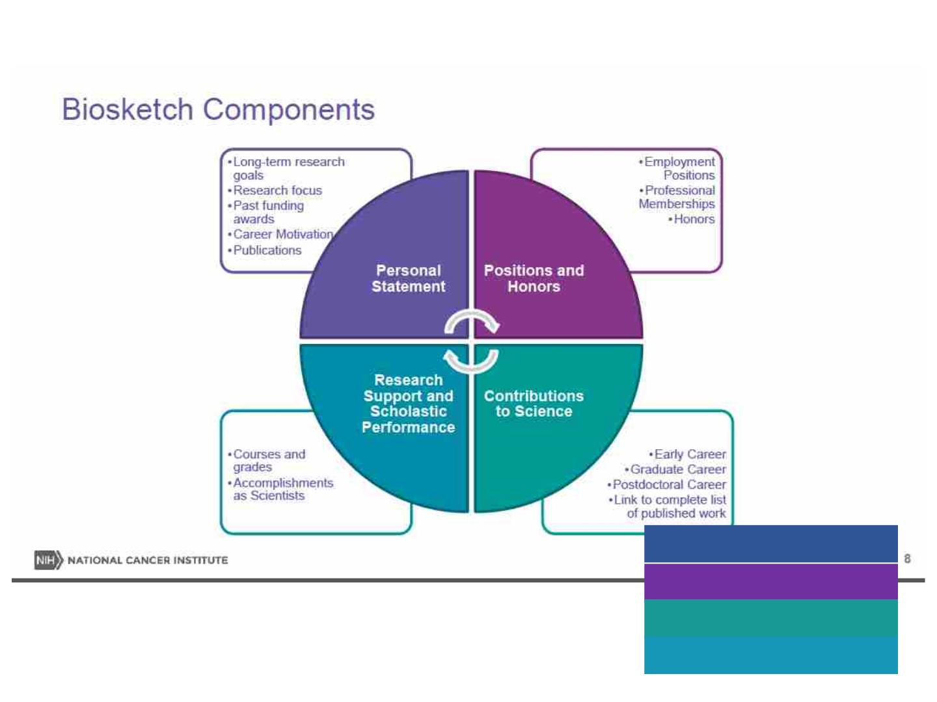
Let’s talk about your Biosketch
Personal Statement
Positions and Honors
Contributions to Science
Research Support

Slide 9

The Biosketch tells your story
Address three areas
• Proposal goal
• Relevant experiences
• Leadership qualifications
The first person “I” is good!
Aiming for about 300-words, half a page
Tailor your Personal Statement to each grant application
Personal Statement
Positions and Honors
Contributions to Science
Research Support

Slide 10

Personal Statement:
Why you are well suited for your role in this project
Long term research goals
• Any relevant training or technical expertise
• Past funding awards
• Career motivation
• Collaborators or scientific environment
Can briefly describe any impediments
• Family care, illness or disability
• Active military service
Add up to 4 publications
or “research products”
that highlight your qualifications
Personal Statement
Positions and Honors
Contributions to Science
Research Support

Slide 11
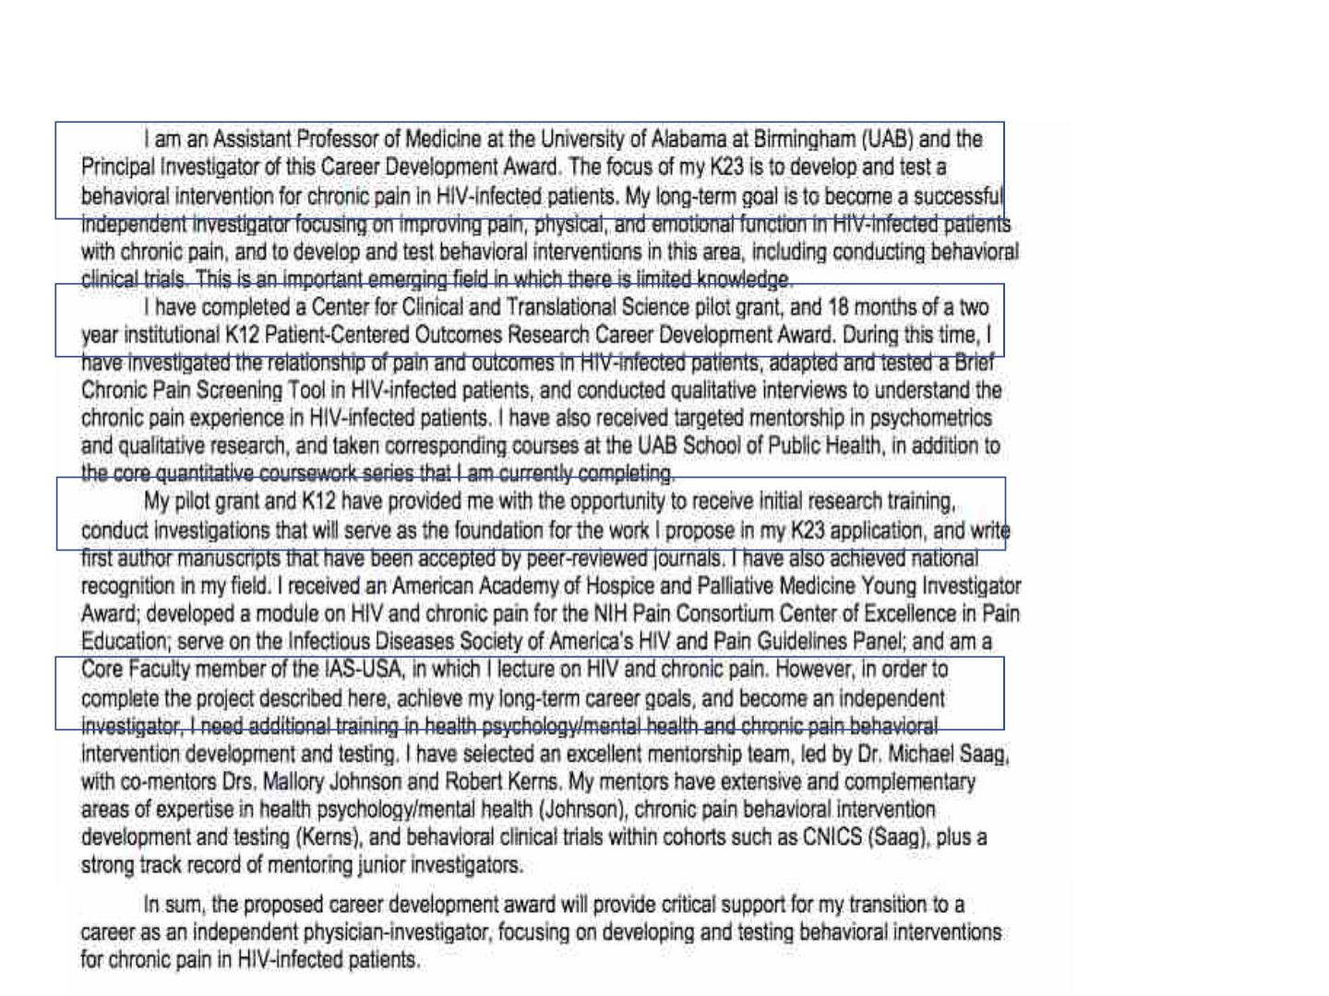
Example of Personal Statement
Mention the grant
mechanism
Speak to purpose
of funding and
proposal goal
Your strengths
Sell your role,why
you need training
Good fit for a K
Merlin K23

Slide 12
Address K23 Review Criteria
Candidate
· Does the candidate have the potential to develop as an
independent researcher?
· Are the candidate's prior training and research experience
appropriate for this award?
· Is the candidate's academic, clinical, and research record of
high quality?
· Is there evidence of the candidate's commitment to become
an independent investigator in research?

Slide 13

Positions and Honors
Research and/or Professional Experience
CHRONOLOGICAL (often just year is enough)
Employment --resident, fellow
Honors-- what specific awards were for
Professional Societies
Personal Statement
Positions and Honors
Contributions to Science
Research Support

Slide 14
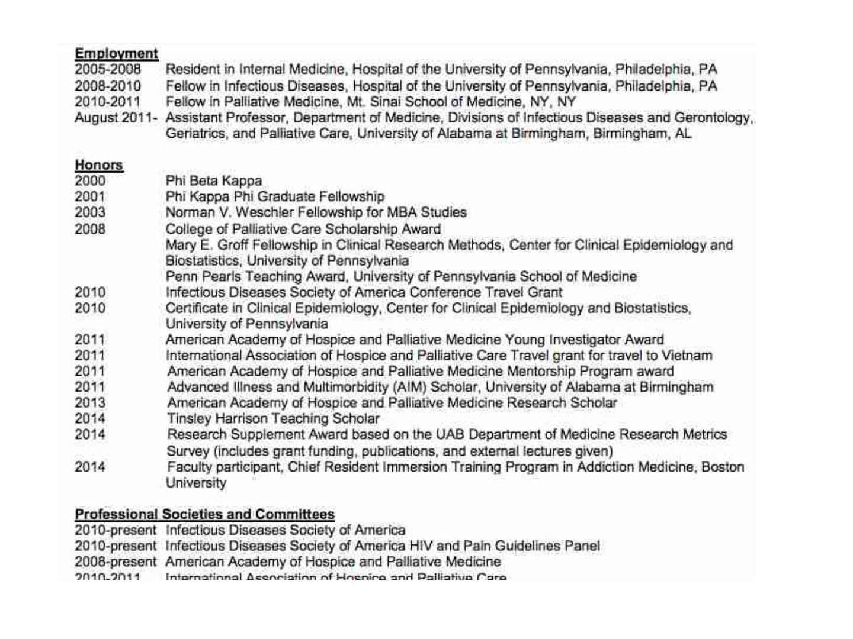

Slide 15

Try it!
NIH Biosketch (Fellowship) Rubric
Points available
Use NIH biosketch format
2 pts
1 pt
Include commons user name
Education/Training complete
2 pts
PERSONAL STATEMENT
Career motivation
mention funding mechanism
proposal goal/long term goal
2pts
2pts
2pts
Relevant experiences
Address any factors that may have affected your past productivity
Previous training, research, collaborators or environment
Leadership qualifications
why are you well-suited for this project?
Highlight up to four publications or research products
2 pts
POSITIONS AND HONORS
List positions in chronological order
List / describe relevant achievements/honors
List professional societies
Indicate licensure
5 minutes to read and score biosketch on your right
Discuss constructive comments

Slide 16

Contributions to Science
(revised in ~2015, note recent examples)
Up to 5 contributions to science, include
Background of problem
Central findings
Influence of findings
Role in the work
up to 4 citations
aim for half a page including citations
Often reflect periods of research or specific projects
postbac IRTA or year out
Personal Statement
medical student research
research in residency
fellowship research
Positions and Honors
Contributions to Science
Research Support

Slide 17
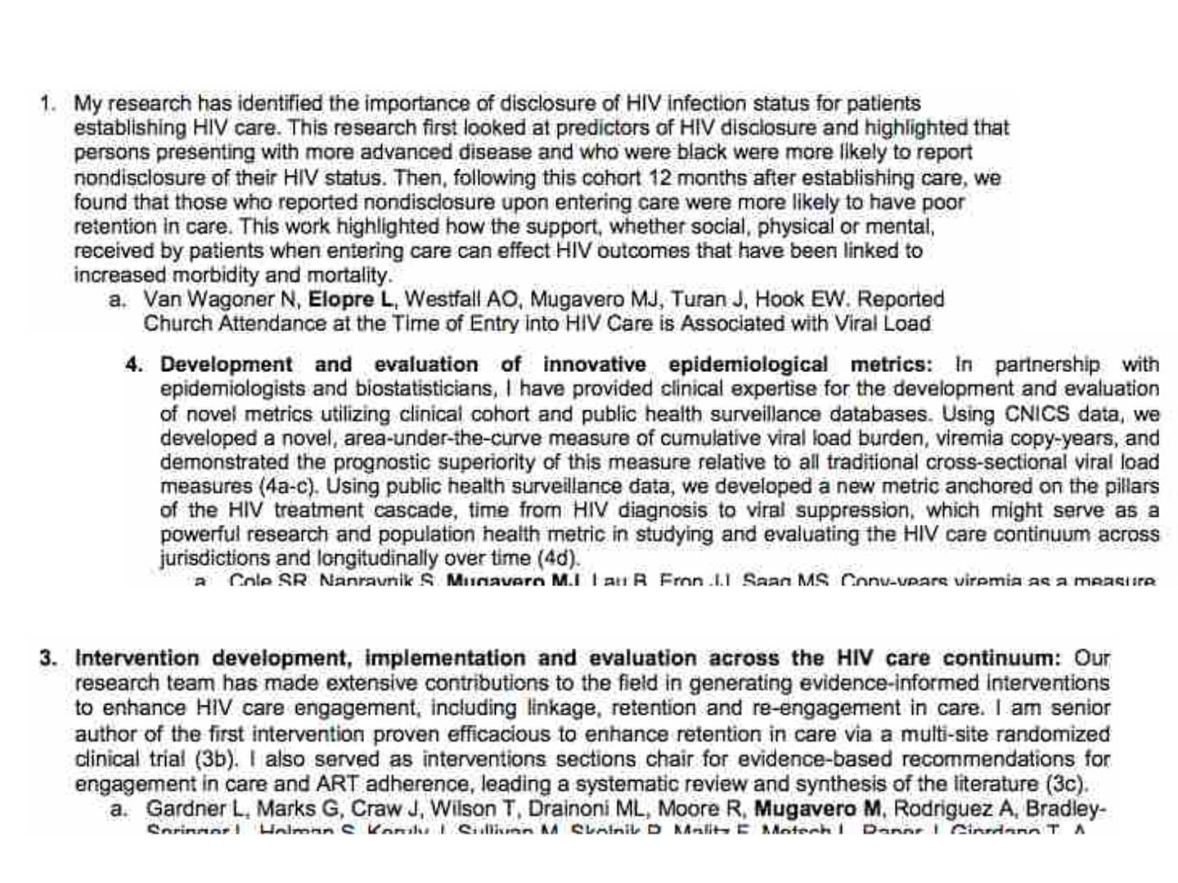
Examples of Contributions to Science

Slide 18
Contribution to Science
Consider describing the impact of your research
“This project produced 11 non-peer reviewed articles, 2 reports for
policy makers, 2 local newspaper articles, 23 presentations to a
variety of policy and academic audiences”
“This project resulted in 10 peer reviewed articles, 2 national
presentations, 4 international presentations.”
”The paper describing this work has been cited > 300 times
(Scopus)”
Personal Statement
Positions and Honors
Contributions to Science
Research Support

Slide 19
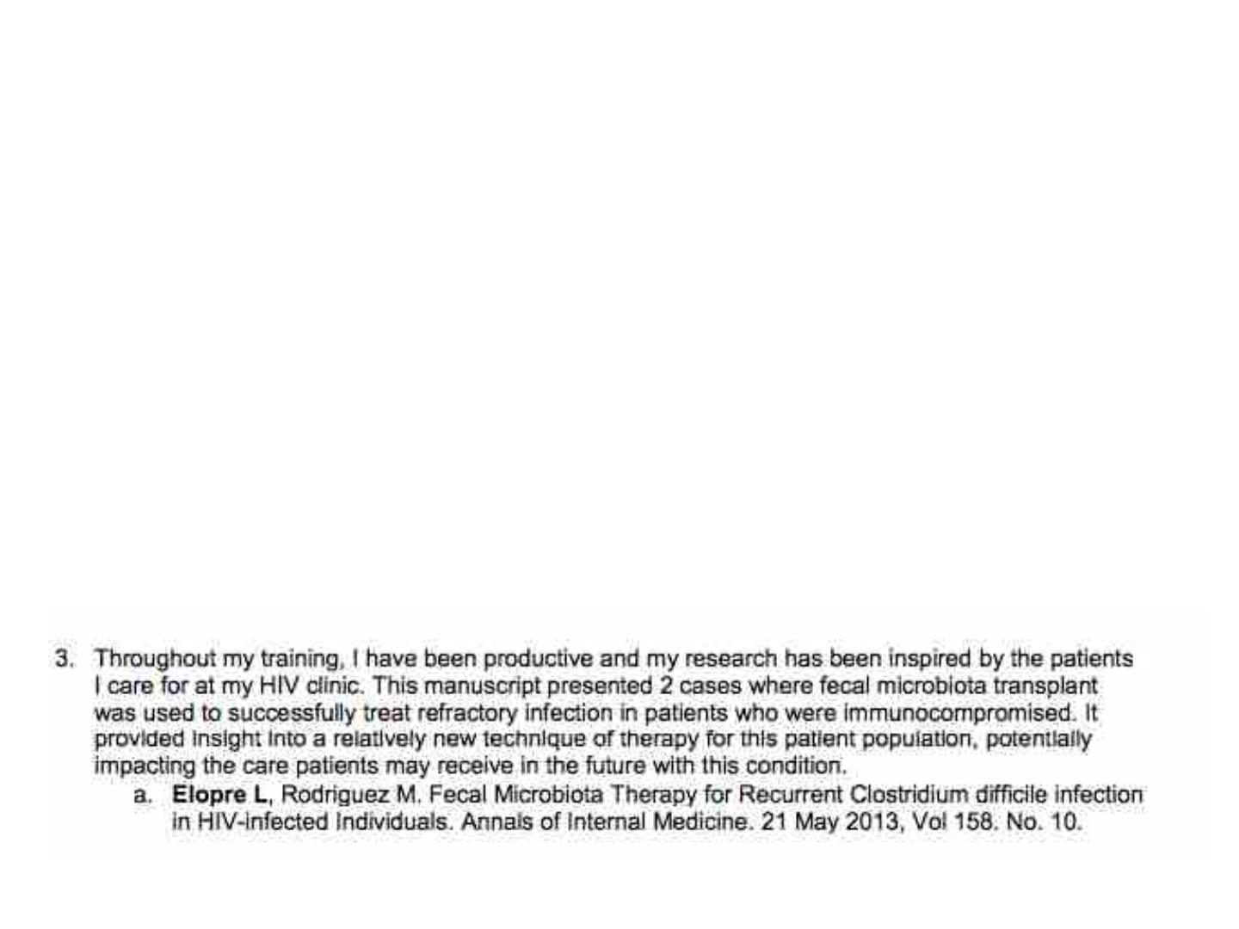
Contributions can be lots of products
Journal articles, book chapters
Audio or video products,
patents, databases and research materials,
educational curricula, instruments or equipment, models,
protocols, software or netware
URLS are not permitted in biosketch
(put “non-standard” items in My NCBI bibliography)

Slide 20
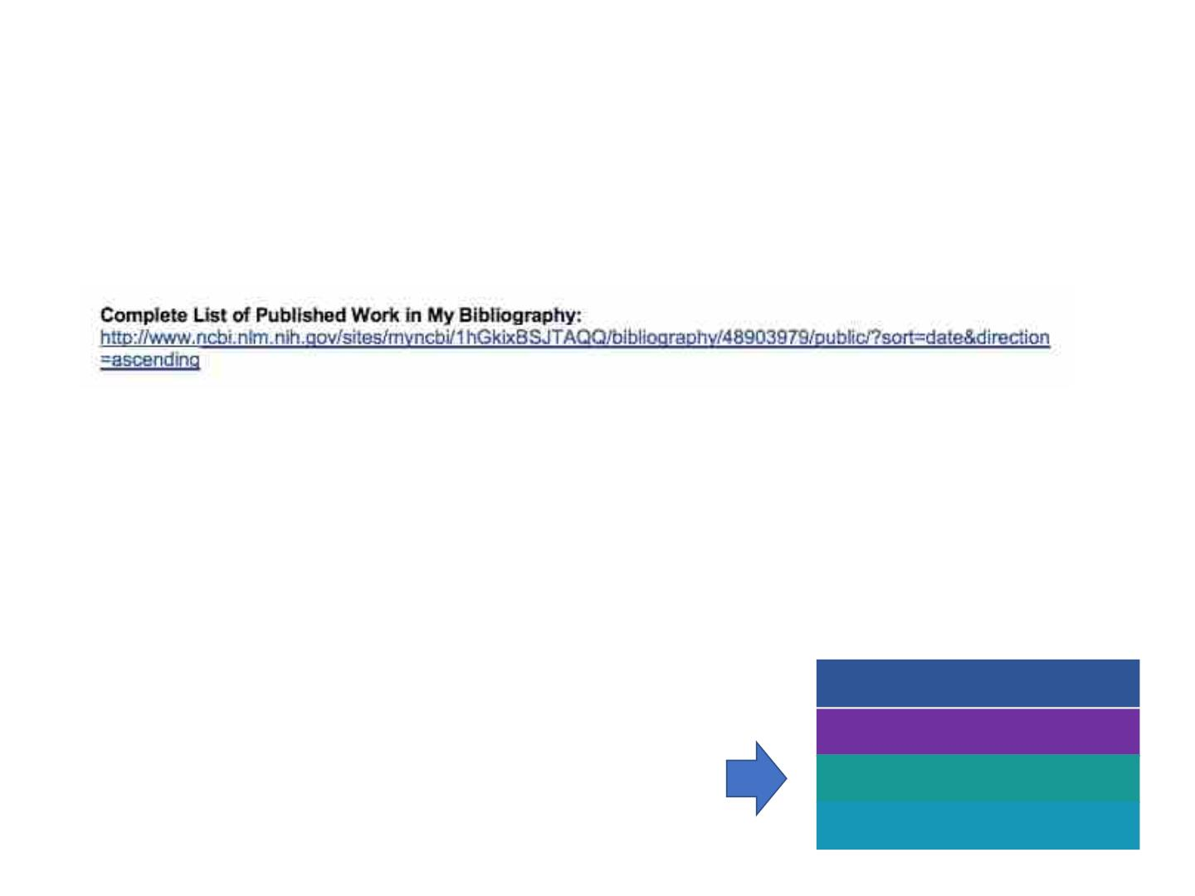
Place UNDER Contribution to Science:
A complete list of published work is available in My Bibliography
ORCID digital identifier that distinguishes you from every
other researcher, links to manuscript and grant
submissions (free registration). https://orcid.org/
Will be mandatory Jan 2020
Personal Statement
https://orcid.org/0000-0002-1825-0097
Positions and Honors
Contributions to Science
Research Support

Slide 21

Research Support
List ongoing and completed research from last three years
• Indicate overall goal of the project and your role
• Do not indicate person months
• Do not indicate direct costs
• Do not confuse with “other support”
Personal Statement
Positions and Honors
Contributions to Science
Research Support

Slide 22

Try it!
CONTRIBUTIONS TO SCIENCE
Up to 5 significant contributions to science
Background/findings/impact/your role
citations
5 pts
COMPLETE LIST OF PUBLICATIONS
List My NCBI
List ORCID ID
2 pts
2 pts
RESEARCH SUPPORT/ SCHOL. PERFORMANCE
Ongoing and completed support last 3 years
Goal/your role (no $ or months)
Not Other support (how you are supported now)
Total points
(of 22)
Comments/ Suggestions
5 minutes to read and score biosketch on your right
Discuss constructive comments

Slide 23
Resources:
Career Development Instructions for NIH and other PHS (Dec 7 2018)
https://grants.nih.gov/grants/how-to-apply-application-guide/forms-e/career-forms-e.pdf
NIH Biosketch page for instructions and examples
https://grants.nih.gov/grants/forms/biosketch.htm
NCI K Award Biosketch (2017)
http://www.cancermeetings.org/taw2017/materials/CURE/2_K%20Award%20Biosketch.pdf
Best Foot Forward David Carroll (2015)
https://unclineberger.org/outcomes/files/2018/09/20150519-Breakfast-Seminar-Carroll.pdf
eRA Commons account
CRI contact Stephanie Bair sbair@childrensnational.org
GW contact Kai-Kong Chan kkchan@email.gwu.edu
My Bibliography reference tool https://www.ncbi.nlm.nih.gov/books/NBK53595/
ORCID https://orcid.org/
Current (Forms-E) forms for applications > Jan 25, 2018
NIH Biosketch video https://www.youtube.com/watch?time_continue=15&v=tqqeip3JsmU

